Slide 1
Advanced Machine Learning
BY
ADNAN AMIN

Slide 2
Core Concept of ML
Machine learning is about designing algorithms that automatically extract valuable information from data.
How automatically?
ML concerned about general-purpose methodologies that can be applied to many datasets, while producing something that is meaningful.
Core concept of ML
Data
Model
Learning
We will study in detail later on.
Notes:
Machine learning is about designing algorithms that automatically extract
valuable information from data. The emphasis here is on “automatic”, i.e.,
machine learning is concerned about general-purpose methodologies that
can be applied to many datasets, while producing something that is meaningful.
There are three concepts that are at the core of machine learning:
data, a model, and learning.

Slide 3
Core concept of ML: DATA
ML inherently data-driven.
The goal of machine learning is to design general purpose methodologies to extract valuable patterns from data, ideally without much domain-speciﬁc expertise.
For example,
Given a large corpus of documents (e.g., books in many libraries), machine learning methods can be used to automatically ﬁnd relevant topics that are shared across documents (Hoffman et al.,2010)

Slide 4
Core concept of ML: MODEL
A model is said to learn from data if its performance on a given task improves after the data is taken into account. (Mitchell,1997)
The goal is to ﬁnd good models that generalize well to yet unseen data, which we may care about in the future.
We are interested in the model to perform well on unseen data.
For example,
To automatically ﬁnd relevant topics that are shared across documents, we design models that are typically related to the process that generates data, similar to model the dataset we are given.
Like: Regression model which the model would describe a function that maps inputs to real-valued outputs.

Slide 5
What do we mean by good models?
It is also not entirely obvious how to objectively deﬁne the word “good”.
One of the guiding principles of machine learning is that good models should perform well on unseen data.
This requires us to deﬁne some performance metrics.
Confusion matrix
Accuracy, f-measure, precision, and recall
Statistical test

Slide 6
Core concept of ML: LEARNING
The learning component of the ML
Learning can be understood as a way to automatically ﬁnd patterns and structure in data by optimizing the parameters of the model.
To get knowledge of something by study, experience, or being taught; to become aware by information or from observation. (Oxford Dict)

Slide 7
Why Mathematics is important for ML?
Mathematical foundations of ML are important in order to understand fundamental principles upon which more complicated ML systems are built.
Facilitate:
creating new machine learning solutions,
understanding and debugging existing approaches,
learning about the inherent assumptions,
limitations of the methodologies.

Slide 8
Finding Words for Intuitions
Predictor:
ML Algorithm to mean a system that makes predictions based on input data.
ML Algorithm to mean a system that adapts (from training data) some internal parameters of the predictor so that it performs well on future unseen input data.
Data as vectors:
numerical representation suitable for reading into a computer program.
a vector as an array of numbers (a Computer Science view)
a vector as an arrow with a direction and magnitude (a physics view)
a vector as an object that obeys addition and scaling (a mathematical view)

Slide 9
Finding Words for Intuitions
Training data:
Performing well on data that we have already seen (training data) may only mean that we found a good way to memorize the data.
Why data represent as vector?
We learn from available data by using numerical optimization methods with the aim that the model performs well on data not used for training.
Matrix:
Data representation in table.
Gradient:
Many optimization techniques require the concept of a gradient, which tells us the direction in which to search for a solution.

Slide 10
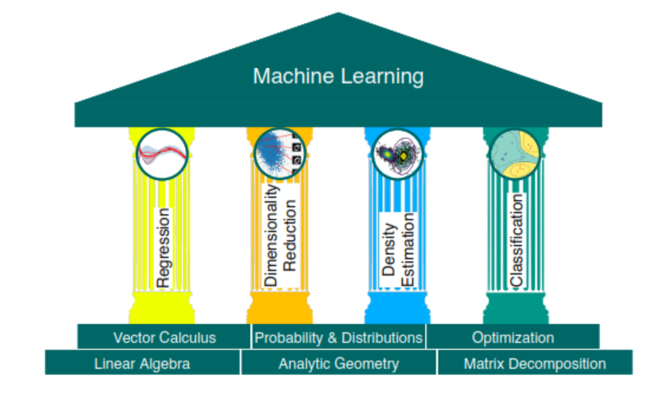
The foundations and four pillars of machine learning.

Slide 11
1. Basic concepts
Linear algebra:
The study of vectors (data as numerical representation) and matrices (data presentation in table) is called linear algebra.
The collection of vectors as a matrix.

Slide 12
Basic Concepts
Analytic geometry:
The construction of similarity and distances is central to analytic geometry.
For example,
Given two vectors representing two objects in the real world, we want to make statements about their similarity.
The idea is that vectors that are similar should be predicted to have similar outputs by our machine learning algorithm.
To formalize the idea of similarity between vectors, we need to introduce operations that take two vectors as input and return a numerical value representing their similarity.

Slide 13
Basic Concepts
Matrix Decomposition:
A matrix decomposition is a way of reducing a matrix into its constituent parts.
simplify more complex matrix operations that can be performed on the decomposed matrix rather than on the original matrix itself.
For example:
Identify and separate the noisy signal from the matrix.

Slide 14
Basic Concepts
Probability Theory:
Quantiﬁcation of uncertainty is the realm of probability theory.

Slide 15
Basic Concepts
Vector Calculus:
Vector calculus and details the concept of gradients.
For example:
To train machine learning models, we typically ﬁnd parameters that maximize some performance measure. Many optimization techniques require the concept of a gradient, which tells us the direction in which to search for a solution.
Set base for optimization as well: where we talk about optimization to ﬁnd maxima/minima of functions.

Slide 16

Linear regression
where our linear regression objective is to ﬁnd functions that map inputs $x∈R^{D}$, to corresponding observed function values $y∈R$, which we can interpret as the labels of their respective inputs.

Slide 17
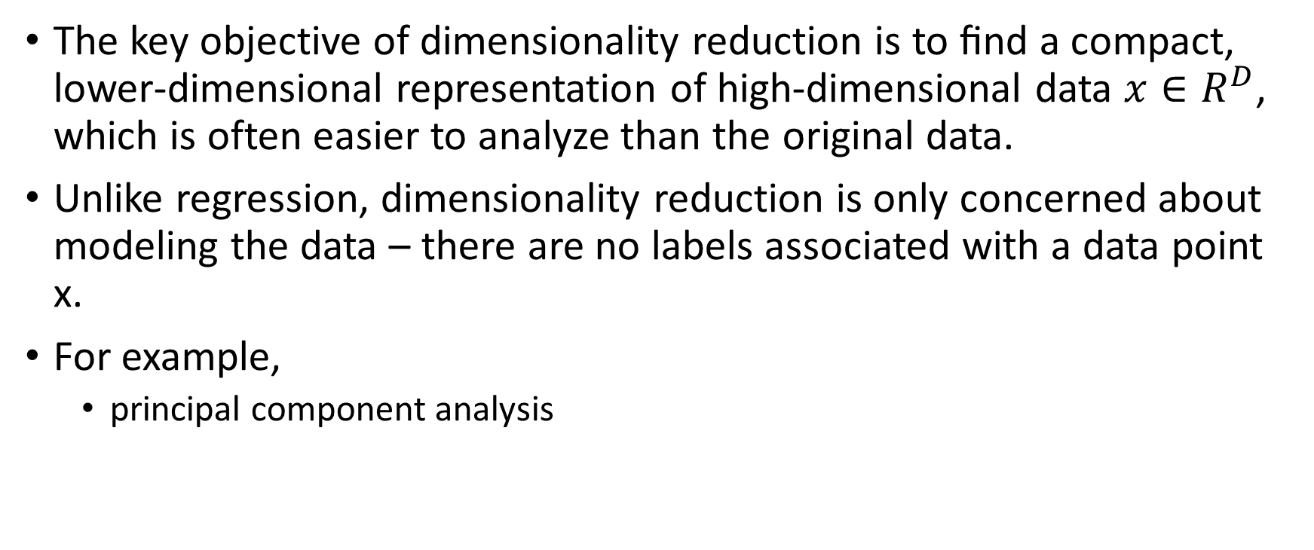
Dimensionality reduction
The key objective of dimensionality reduction is to ﬁnd a compact, lower-dimensional representation of high-dimensional data $x∈R^{D}$, which is often easier to analyze than the original data.
Unlike regression, dimensionality reduction is only concerned about modeling the data – there are no labels associated with a data point x.
For example,
principal component analysis

Slide 18
Density estimation
The density estimation objective of density estimation is to ﬁnd a probability distribution that describes a given dataset.

Slide 19
Classiﬁcation
we have inputs x and corresponding labels y. However, unlike regression, where the labels were real-valued, the labels in classiﬁcation are integers, which requires special care.

Slide 20
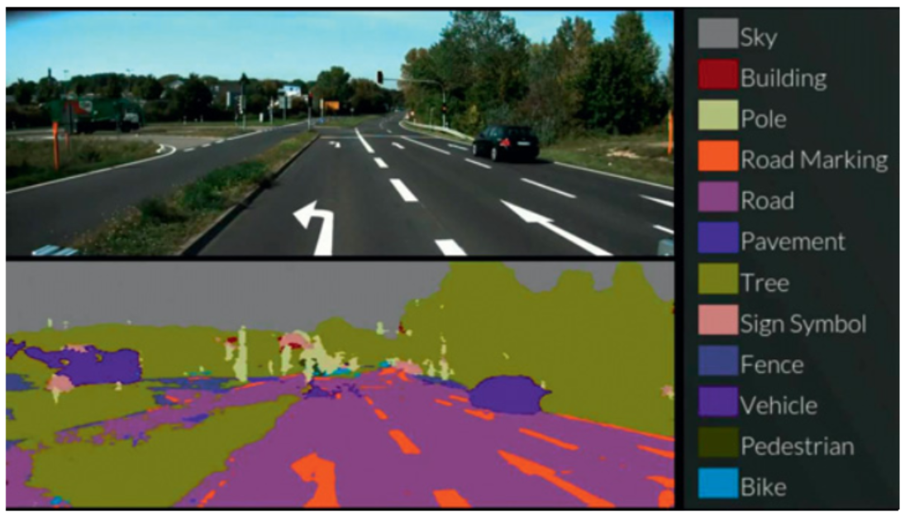
ML Applications: Self-Driving Car

Slide 21
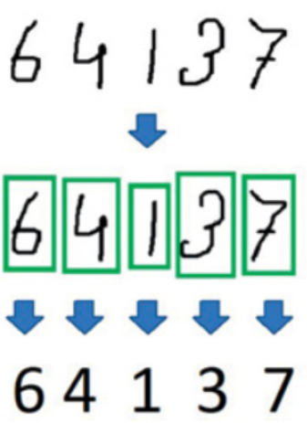
ML Applications: Problem of optical character recognition

